Slide 1


Prediction models for diabetes classification can identify patients treated as having Type 2 diabetes who rapidly progress to insulin therapy.
E de Villiers, A Hill, D Fraser, R Bolt, T McDonald, B Shield, A Jones
StartRight

Slide 2

A clinical case: Theresa May¹
Treated for diabetes as type 2, initially with lifestyle changes
Required further glucose-lowering oral medication
Following ineffective treatment, began early insulin treatment. Shortly after re-diagnosed as type 1
“My very first reaction, was that [getting type 1 diabetes is] impossible because at my age you don’t get it.”
¹https://www.diabetes.org.uk/about_us/news/balance-interview-with-theresa-may
Notes:
Diagnosis treatment: lifestyle changes ineffective, glucose-lowering oral medications ineffective, progressed to early insulin effective, rediagnosed as type-1

Slide 3
Diagnosing type 1 in adults is difficult
~40% of classical type 1 patients diagnosed over 30 are initially misdiagnosed¹
Nearly all these patients require insulin treatment within 3 years¹
Previous studies have developed type 1 diabetes classification models²
Combine routine features, optional islet auto-antibodies and type 1 genetic risk score
High performance in cross sectional data for T1D defined by C-peptide², genetically³, and by pancreatic histology⁴
Models developed for ages 18-50
Models have NOT been tested at diagnosis
¹ Thomas NJ, et al. Type 1 diabetes defined by severe insulin deficiency occurs after 30 years of age and is commonly treated as type 2 diabetes
² Lynam A, et al. Development and validation of multivariable clinical diagnostic models to identify type 1 diabetes requiring rapid insulin therapy in adults aged 18-50 years.
³ Thomas NJ, et al. Identifying type 1 and 2 diabetes in research datasets where classification biomarkers are unavailable: assessing the accuracy of published approaches
⁴ Carr ALJ, et al. Histological validation of a type 1 diabetes clinical diagnostic model for classification of diabetes.
Notes:
Classical type 1 = absolute insulin deficiency, and with genetics and antibody profile

Slide 4
Aim
To determine whether previously developed type 1 diabetes risk models can identify patients initially treated as type 2 diabetes (without insulin), who rapidly progress to insulin treatment.

Slide 5
Methods: Study Cohort
Participants initially treated without insulin in the prospective StartRight Study (n = 957)
Annual follow up for 2 years
Median diabetes duration 2.4 years at latest follow up
Diagnosed age 18+, diagnosis within previous 12 months
Rapid progression to insulin defined as insulin treatment within 2 years of recruitment
Notes:
Is ongoing study, which will validate models longer-term against c-peptide deficiency

Slide 6
Methods: Models
3 previously developed models:
Clinical Features = BMI and Age at diagnosis
Clinical Features + GAD and IA2
Clinical Features + GAD + IA2 + Type 1 Diabetes Genetic Risk Score (T1DGRS)
Assessed models:
Discrimination = area under ROC Curve (AUROC)
Calibration = predicted model probabilities plotted against observed outcome %
Notes:
According to the article, the Type 1 Diabetes Genetic Risk Score (T1D GRS) was developed using information from 30 single nucleotide polymorphisms (SNPs) associated with Type 1 diabetes.
https://diabetesjournals.org/care/article/39/3/337/37211/A-Type-1-Diabetes-Genetic-Risk-Score-Can-Aid

Slide 7
Results
Notes:
Add mean time from diagnosis to study recruitment

Slide 8
Those with early insulin treatment have T1D characteristics
Median Characteristics | Did not Progress to Insulin | Progressed to Insulin | p
n | 816 | 141 | /
Diabetes duration at latest follow-up (years) | 2.4 | 2.5 | > 0.05
BMI | 32.4 | 25.6 | << 0.005
Age at Diagnosis | 48 | 44 | < 0.005
HbA1c at diagnosis | 58 | 92 | << 0.005
Antibody Positive (%) 2 Anti. Positive (%) | 6% 1% | 63% 38% | << 0.005
T1D GRS | 0.23 | 0.27 | << 0.005
Notes:
130/141 PROGRESSED have V3 or V2 date contacted =~ 10% missing
748/816 PROGRESSED have V3 or V2 date contacted =~ 10% missing
Overall, about 10% of cohort missing either Date of Diagnosis, or both V2 + V3 date contacted
Speaking:
Make table relevant: although those that progress treated as type 2, suggestive of type 1: in line with type 1; lower bmi, somewhat diagnosed earlier, more severe presentation, 2/3 antibody positive with about 40% multi antibody positive, in stark contrast to those who didn’t progress
.22 exactly expected as type 2, .28 score expected in classical childhood type 1 diabetes

Slide 9
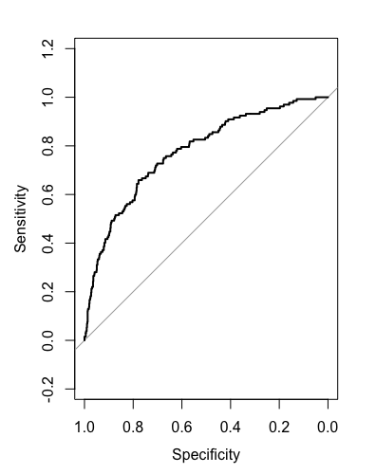
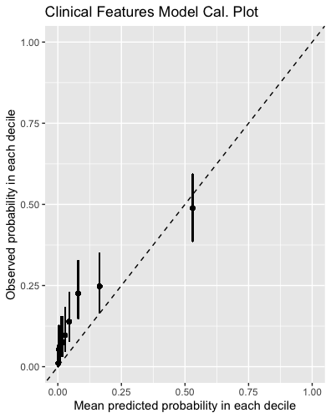
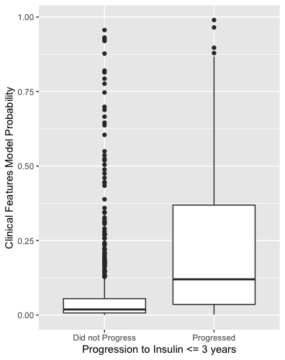
Clinical Features Model discriminates for insulin progression (n = 934)
AUROC = 0.78
Notes:
receiver operating characteristic curve (ROC)

Slide 10
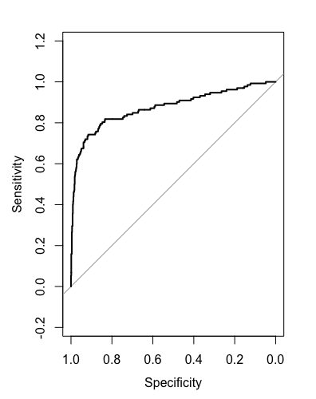
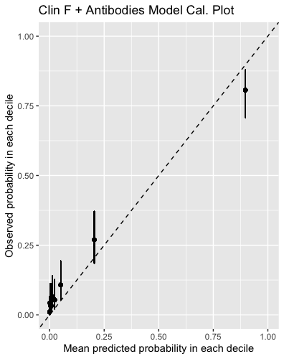
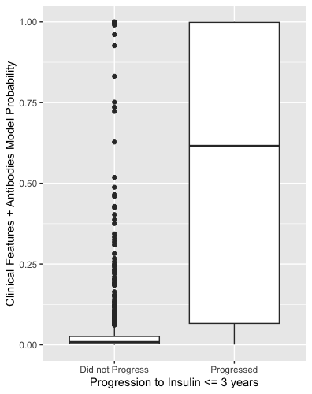
Clinical Features + Antibodies Model significantly improves discrimination (n = 931)
AUROC = 0.87

Slide 11
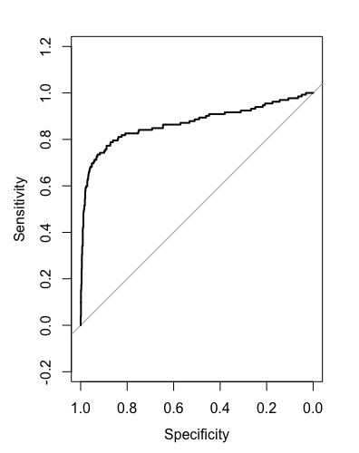
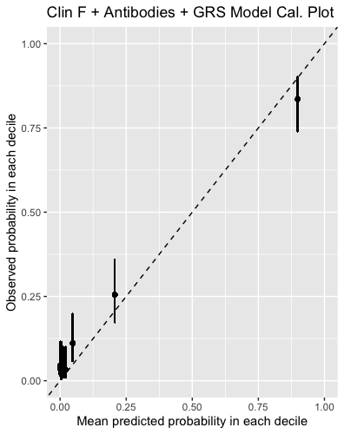
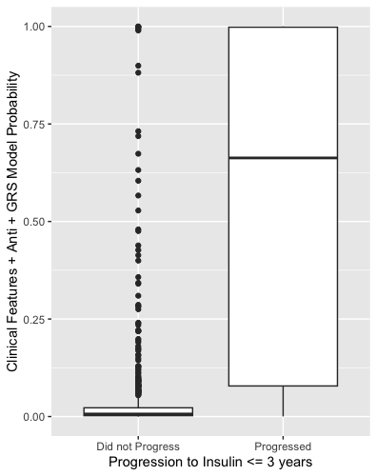
Adding T1DGRS does not improve discrimination (n = 903)
AUROC = 0.87

Slide 12
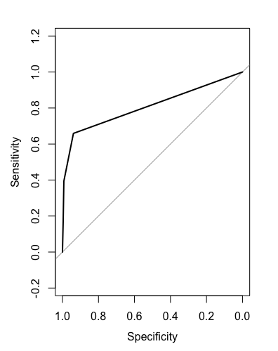
Models incorporating islet autoantibodies have higher discrimination than islet autoantibodies alone (n = 903)
Antibodies Alone
Clin F + Antibodies Model
AUROC = 0.80
AUROC = 0.87
Notes:
Possible addition to conclusion: Antibodies don’t provide a probability – only a positive/negative

Slide 13
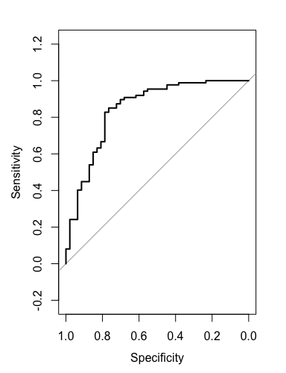
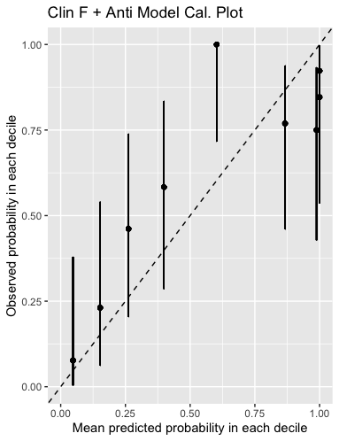
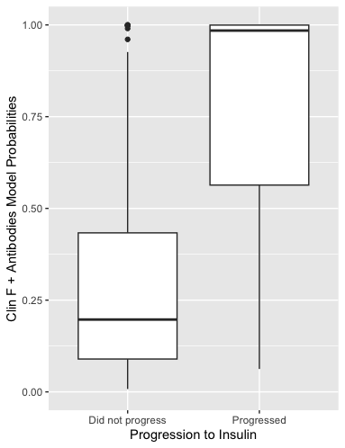
Clin F + Antibodies Model discriminates for insulin progression in antibody positive group (n = 134)
84
AUROC = 0.83
Notes:
84 progressed

Slide 14
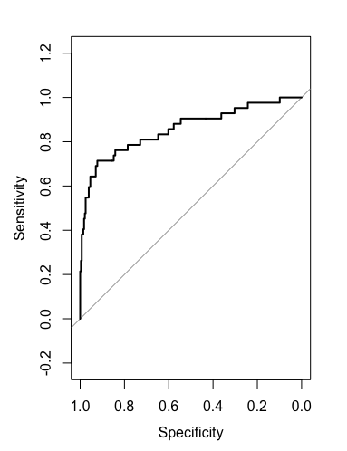
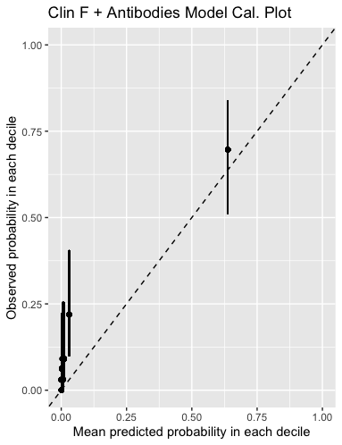
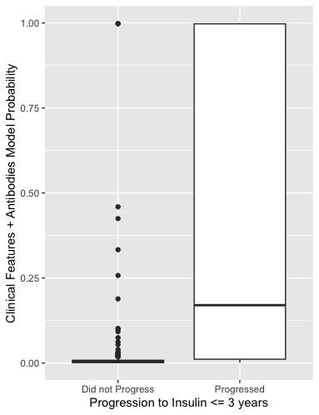
Clin F + Antibodies Model shows good discrimination in diagnosed >50 years (n = 326)
42
AUROC = 0.86
Notes:
42 progressed

Slide 15
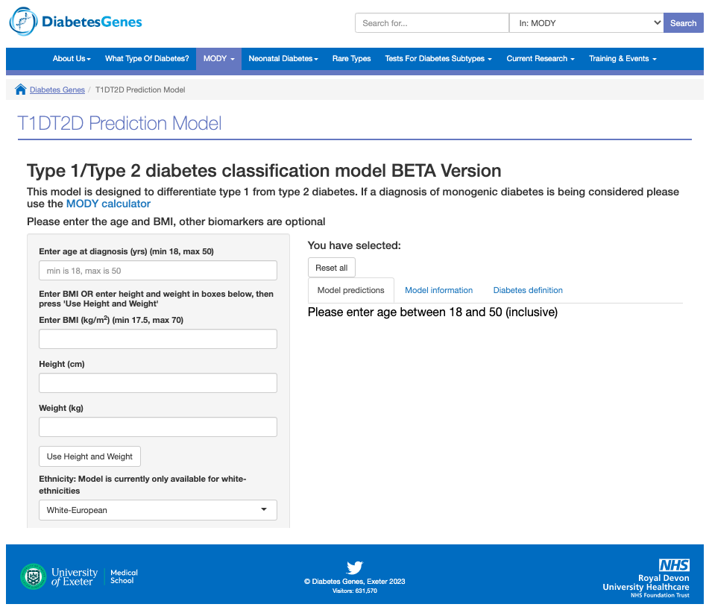

Slide 16
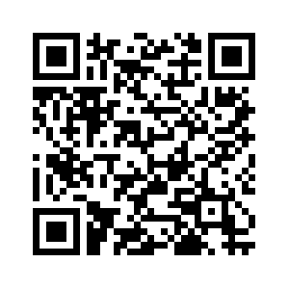
Conclusion
Prediction models for identifying adult onset T1D have high performance for identifying adults initially treated without insulin who progress to insulin within 3 years of diagnosis
Models improve prediction of early insulin over and above use of islet-antibodies alone
Notes:
Speaking: “Wthout insulin” == make HUGE refernce to patients being treated AS TYPE 2 (without insulin)

Slide 18
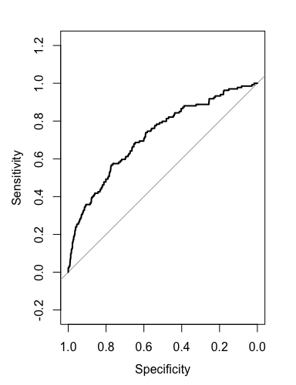
Clinical Features Model discriminates for Single antibody positivity
AUC ROC = 0.72
Notes:
134 single anti positives
58 multi anti positives
REDO! Reworked Single Antibody Positivity

Slide 19
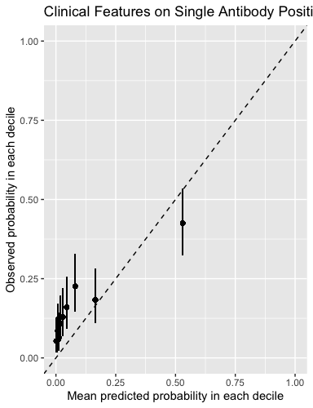
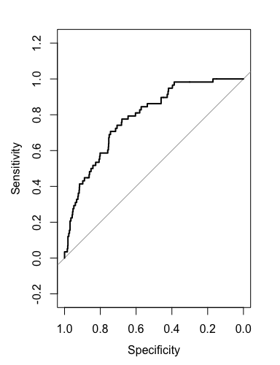
Clinical Features Model discriminates for multi-antibody positivity
AUC ROC = 0.79
Notes:
134 single anti positives
58 multi anti positives
REDO! Reworked Single Antibody Positivity

Slide 20
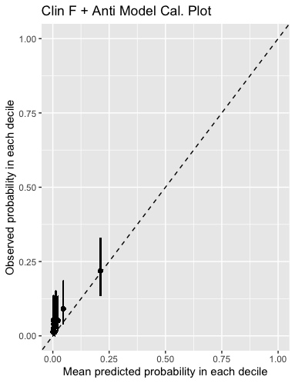
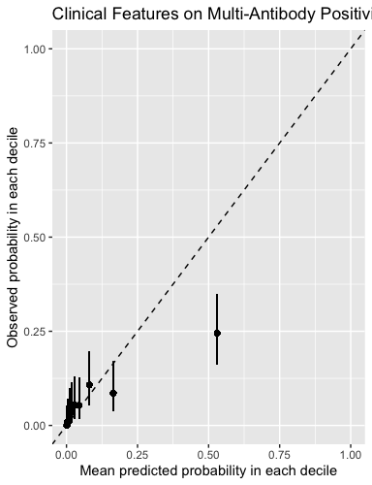

Clin F + Antibodies Model discriminates for insulin progression in antibody negative group (n = 775)
AUC ROC = 0.71
Notes:
Add how many have rapid progression

Slide 21
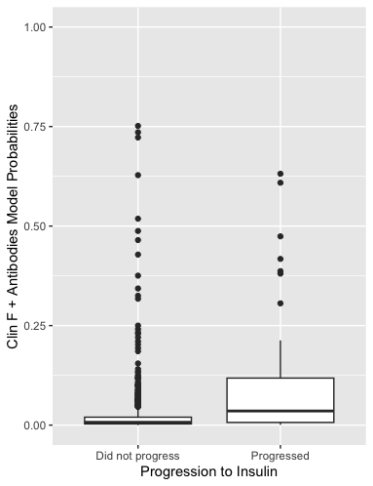
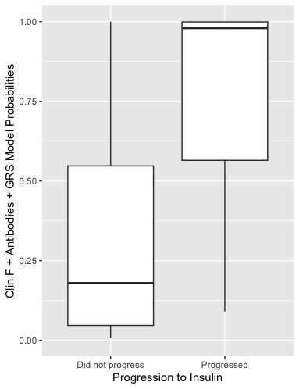
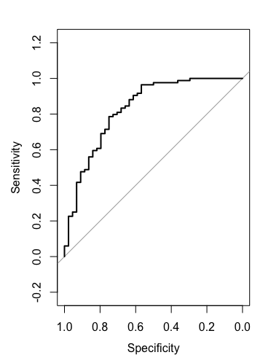
Clin F + Antibodies + GRS Model does not improve discrimination in antibody positive
AUC ROC = 0.83

Slide 22
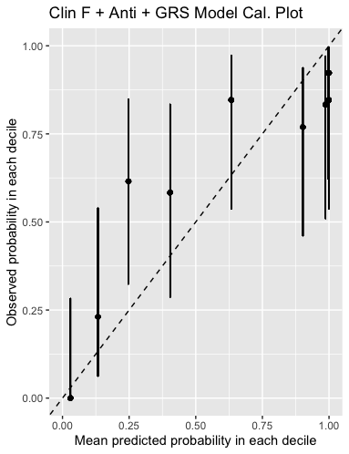
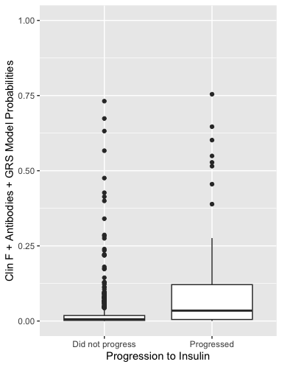
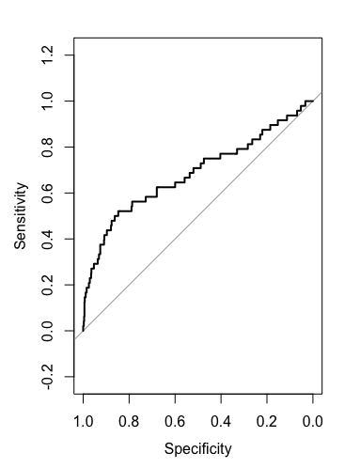
Clin F + Antibodies + GRS Model does not improve discrimination in antibody negative
AUC ROC = 0.68

